Slide 1
OGC API – EDR Sprint #2
Day 2 |
November 10th, 2020
#OGCAPI

Slide 2

Organization of sprint sponsored by:

Slide 3
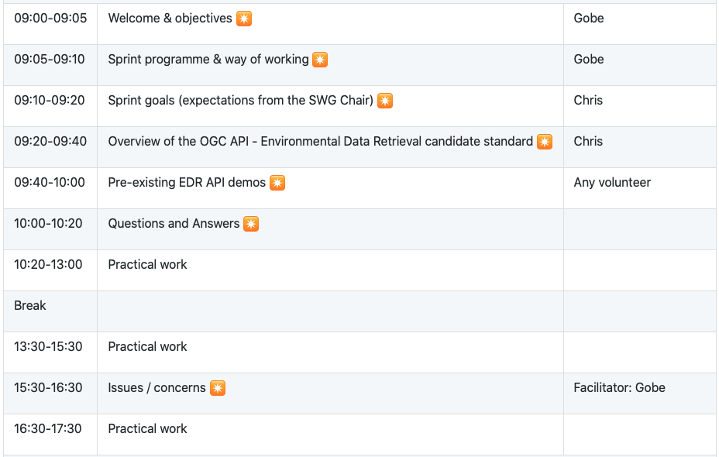
Sprint Schedule: November 9th, 2020

Slide 4
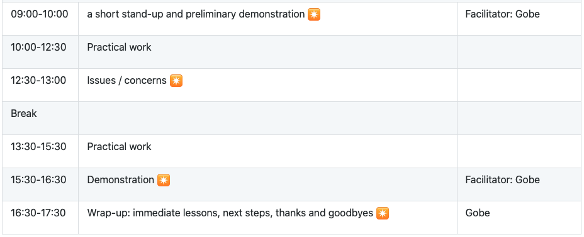
Sprint Schedule: November 10th, 2020

Slide 5
Logistics
Gotomeeting
Link to be provided to registered participants only.
Gitter
https://gitter.im/opengeospatial/OGCAPI-EDR-Sprint2
GitHub
Sprint repo https://github.com/opengeospatial/OGCAPI-EDR-Sprint2

Slide 6
Community
500+ International Members
110+ Member Meetings
60+ Alliance and Liaison partners
50+ Standards Working Groups
45+ Domain Working Groups
25+ Years of Not for Profit Work 10+ Regional and Country Forums
Innovation
120+ Innovation Initiatives
380+ Technical reports
Quarterly Tech Trends monitoring
Standards
65+ Adopted Standards
300+ products with 1000+ certified implementations
1,700,000+ Operational Data Sets Using OGC Standards
Contact info@ogc.org to schedule a meeting for an in-depth discussion with OGC staff and join our community today!
Notes:
If you have any questions, do not hesitate to reach out to OGC or schedule a follow-up. We’re working constantly to change the landscape of location information and want to help your organization get where it needs to go.

